Slide 1

AUTOMATIC LICENSE NUMBER PLATE DETECTION AND RECOGNITION
Prashant kadam.
PGA 38 Batch

Slide 2


introduction
In Today’s Day and Age Security has become one of the biggest concerns for any organization, and automation of such security is essential. However, many of the current solutions are still not robust in real-world situations, commonly depending on many constraints. In the following project, we will understand how to recognize License number plates using the Python programming language. We will utilize OpenCV for this project in order to identify the license number plates and the python OCR for the characters and digits extraction from the plate.

Slide 3

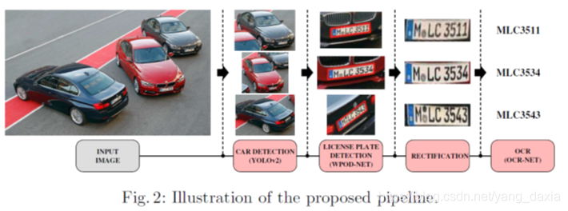
Objective
The objective of this deep learning project is to develop a robust and efficient system for automatic vehicle number plate recognition (ANPR). The system will utilize state-of-the-art deep learning techniques to accurately detect and extract number plates from vehicle images, enabling real-time and accurate recognition of alphanumeric characters present on the plates..
The ultimate objective is to develop a reliable and efficient tool for effortless vehicle number plate recognition

Slide 4




Modules
Reading and visualizing images using OpenCV with Python.
Extracting number plate text using EasyOCR

Slide 5







Workflow
Live Detection
OCR
Model
DATA
Grey Scale
Masking

Slide 6
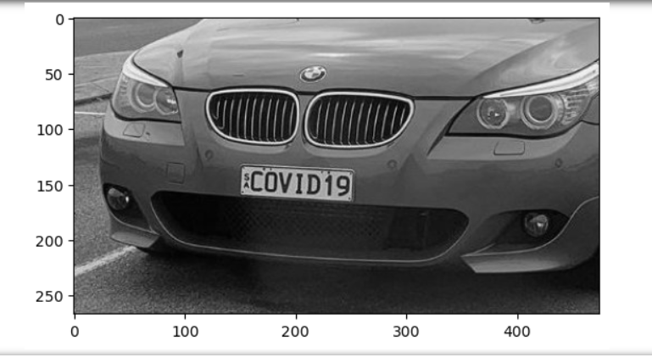
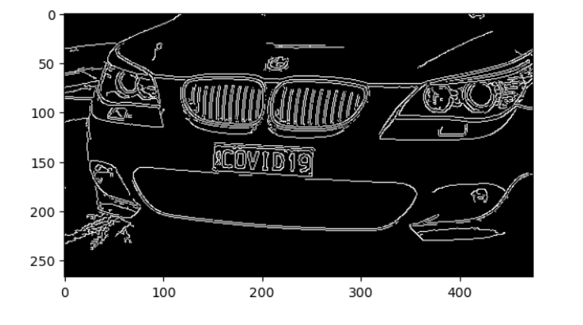
Step : 1 Greyscale This is a very important step, in this process we will take each and every image and convert it into an array using OpenCV.
Step : 2 localization Applying filters and finding edges are typically the initial steps in the localization process, So model can identify key features and edges that are essential for recognizing and localizing objects in the image.

Slide 7
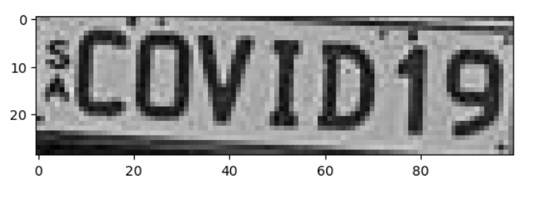
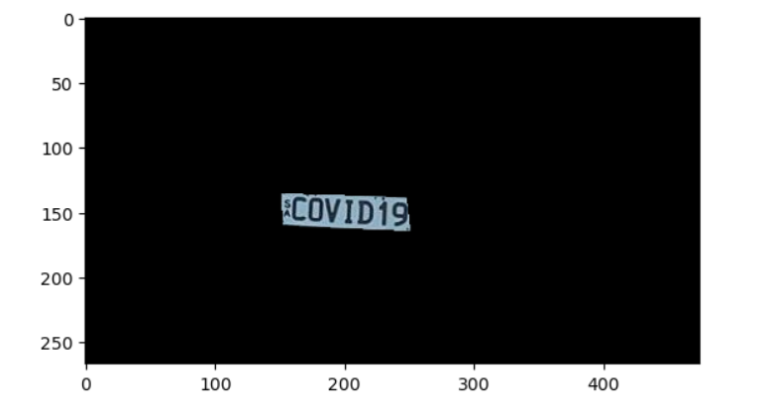
Step : 4
By applying the mask, you effectively isolate the objects of interest from the background, making it easier for further analysis or object recognition tasks
Step : 3 Masking
the combination of finding contours and applying masks is a crucial step in object detection models. These techniques help to identify and extract individual objects, allowing for more precise and accurate analysis and recognition of objects within an image.

Slide 8
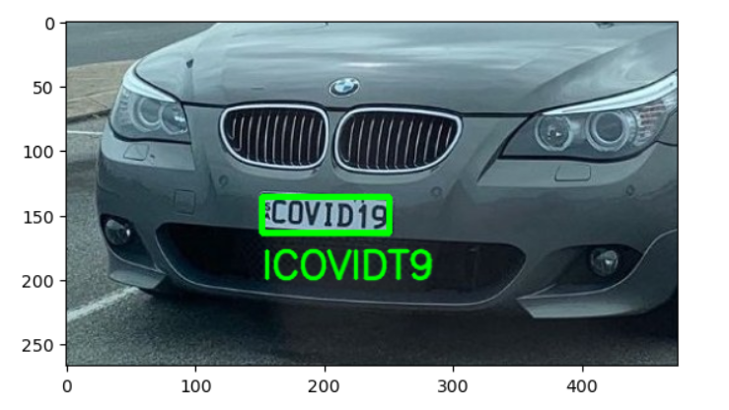
Step : 5 Easy OCR to read text
EasyOCR is a popular open-source Python library that makes text extraction from images straightforward and efficient. When combined with an object detection CNN model, EasyOCR can enhance the capabilities of the model by adding text recognition functionality.
EasyOCR adds a valuable text recognition layer to an object detection CNN model, enabling it to not only detect objects in images but also extract the text from those objects. This integration opens up opportunities for a wide range of applications, such as document analysis, scene understanding, and real-time text extraction from images

Slide 9

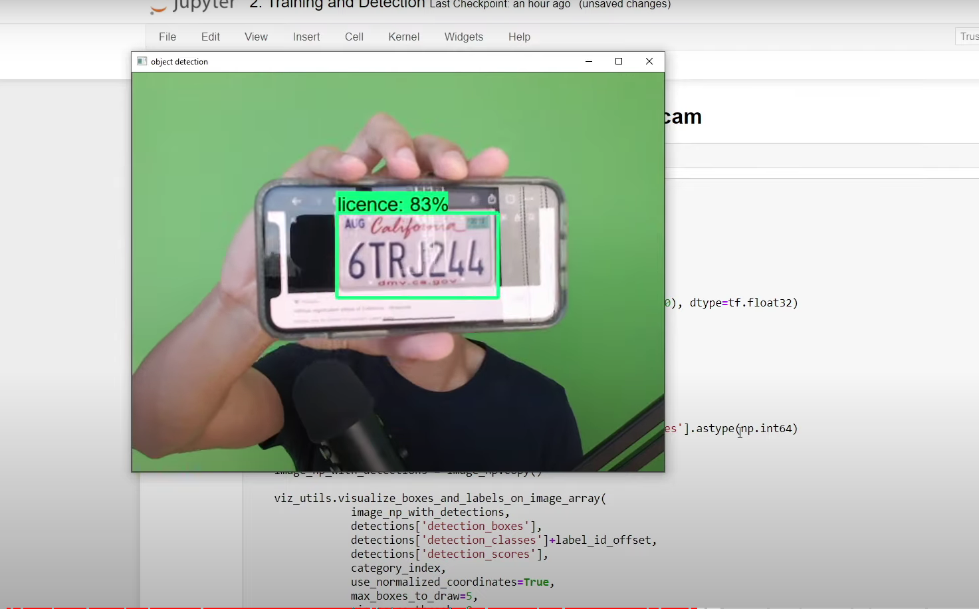
Real time detection from webcam
Haarcascades are a type of object detection technique that can be effective for simple tasks like license plate detection.
As mentioned earlier, while Haarcascades are simple to implement and can work for basic tasks, modern deep learning-based object detection models, such as YOLO or SSD, typically offer more accurate and robust results for license plate detection. Additionally, integrating EasyOCR or other OCR libraries can enhance the script's capability to recognize the license plate numbers from the detected regions.

Slide 10
Difficulties & best practices
1.Variability in License Plate Formats: License plates can have various formats, including different font styles, sizes, and colors. This variability can make it challenging for the deep learning model to generalize across different plate types. To overcome this, ensure your training dataset includes a diverse range of license plate formats, capturing various regions and countries.
2.Low-Quality Images: License plate images captured in real-world scenarios may have low resolution, noise, or be affected by different lighting conditions. Preprocessing techniques, such as image enhancement, denoising, and normalization, can help improve the quality of images before feeding them to the deep learning model.
3.Occlusion and Overlapping Objects: License plates can be partially occluded or obscured by other objects, making it difficult for the model to detect and recognize them. Employ multi-stage approaches that involve object detection models to locate license plate regions first and then apply OCR specifically to those regions.
4.Different Languages and Characters: License plates may contain characters from different languages or character sets. Ensure that your OCR system supports the languages present in your dataset. Additionally, you might need to adapt the OCR model to recognize specific characters unique to certain regions.
5.Real-Time Performance: Real-time license plate recognition requires efficient models and algorithms to process frames quickly. Optimize the deep learning models for speed and consider using hardware acceleration techniques like GPU or specialized hardware (e.g., TPU) to achieve real-time performance.

Slide 11

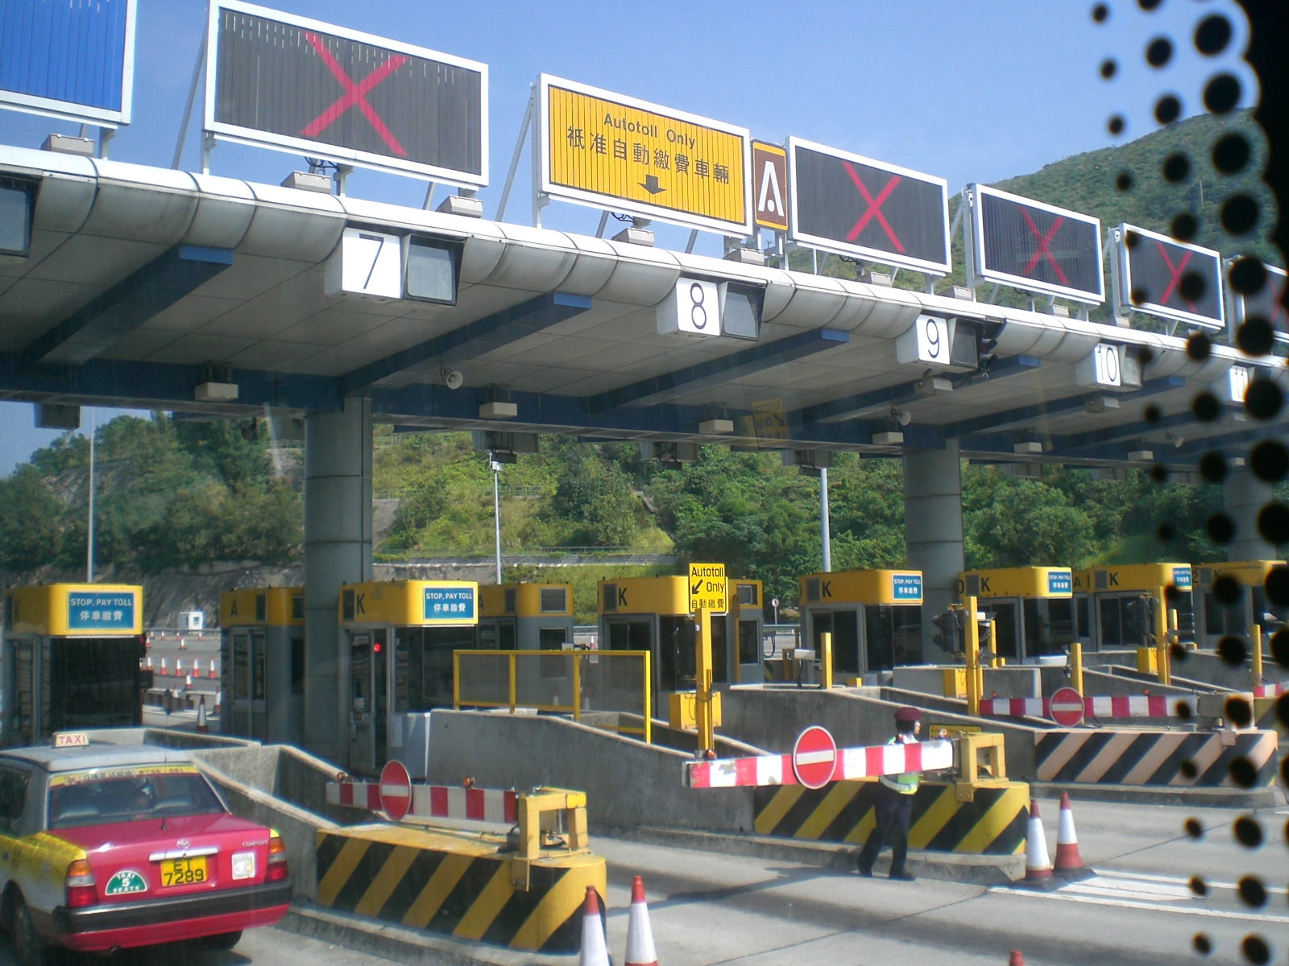
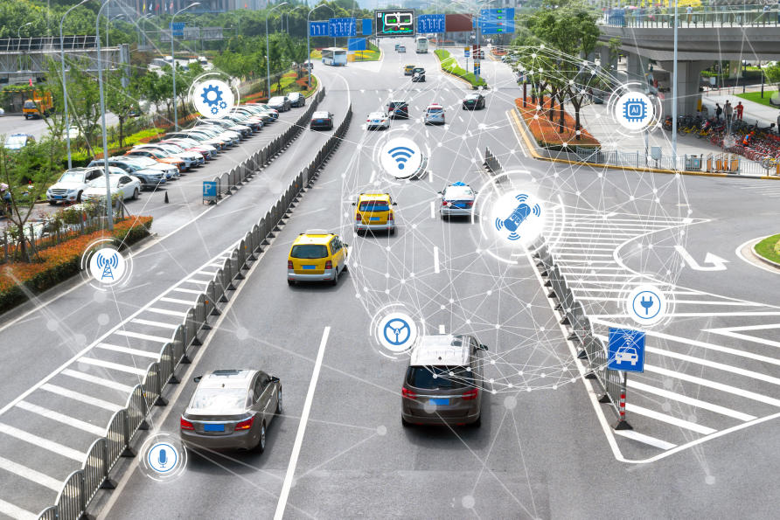
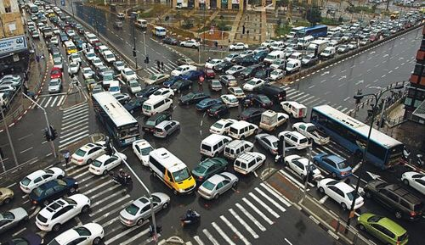







Use case
License plate detection is identifying the part of the car that is predicted to be the number plate. Recognition is identifying the values that make up the license plate. License plate detection and recognition is the technology that uses computer vision to detect and recognize a license plate from an input image of a car. This technology applies in many areas. On roads, it is used to identify the cars that are breaking the traffic rules. In security, it is used to capture the license plates of the vehicles getting into and out of certain premises. In parking lots, it is used to capture the license plates of the cars being parked. The list of its applications goes on and on.
Vehicle parking
Toll Enforcement
Vehicle Servellence
Traffic
Management

Slide 12
conclusion
we successfully developed a robust and efficient license plate recognition system using deep learning models with OpenCV and OCR. The system accurately detects and extracts license plates from vehicle images in real-time, overcoming challenges such as varying plate formats and occlusion. By integrating EasyOCR, the system efficiently recognizes alphanumeric characters from the extracted plates. The achieved high accuracy and real-time performance make this system highly promising for practical applications in law enforcement, parking management, and traffic analysis. This project not only enhances our understanding of object detection and OCR techniques but also lays the foundation for future advancements in license plate recognition systems.
Thank you !

